Slide 1
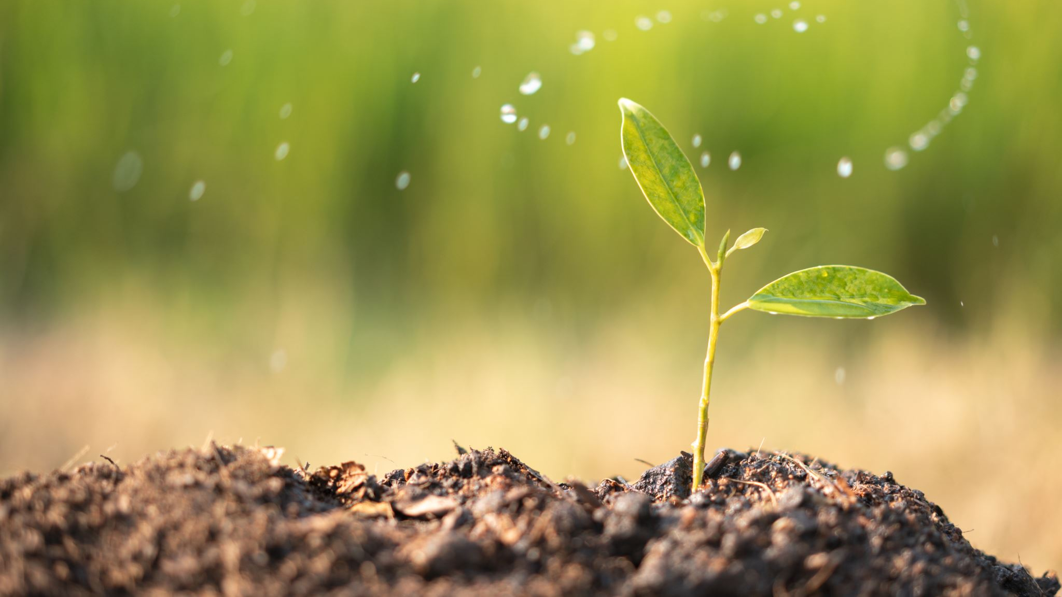
Assessing Climate Change Impacts on Global Agriculture: Past Trends and Future Mitigation Strategies
Sean McLean
ALY 6060
Final Project

Slide 2
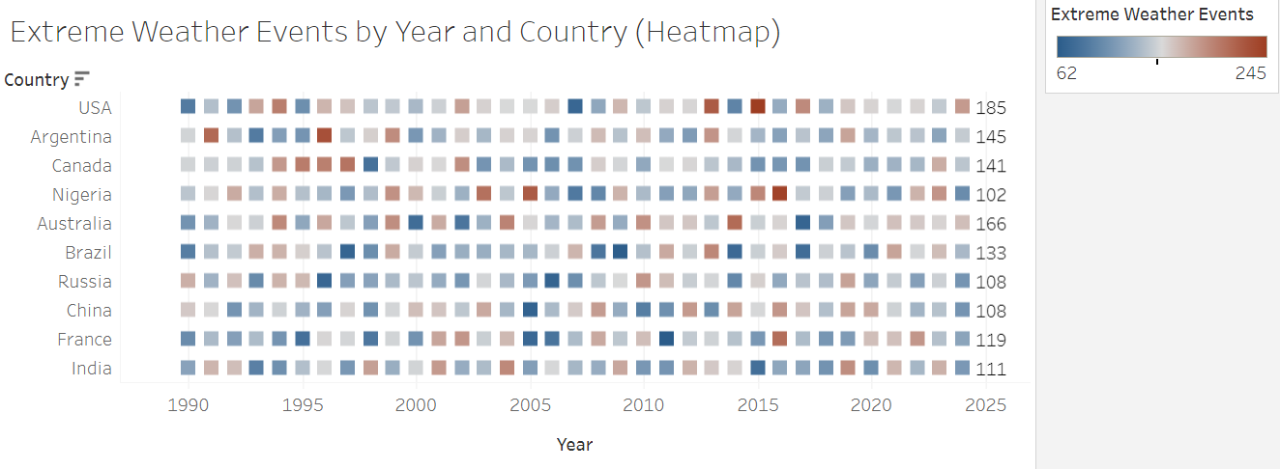
Climate Change Impact: Focus on climate change’s effect on agriculture and mitigation efforts since 1990.
Key Agricultural Metrics: Evaluates irrigation, soil health, and fertilizer use on crop yields.
Extreme Weather Heatmap: Shows inconsistent extreme weather events, especially in the last five years, due to global warming.
Adaptation Needs: Countries must adapt, prioritize economic stability, and reduce emissions to combat future climate impacts.

Slide 3
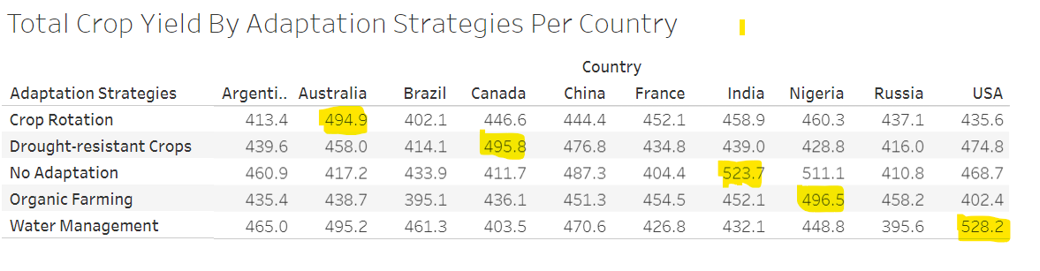
Total Crop Yield By Adaptation Strategies Per Country
Crop Yield Comparison: Five bar charts show crop yield by adaptation strategies per country over 25 years.
Adaptation Strategies: Countries used strategies like crop rotation, drought-resistant crops, and organic farming to adapt.
Country Highlights: Canada led in drought-resistant crops, Nigeria in organic farming, and the U.S. in water management.

Slide 4
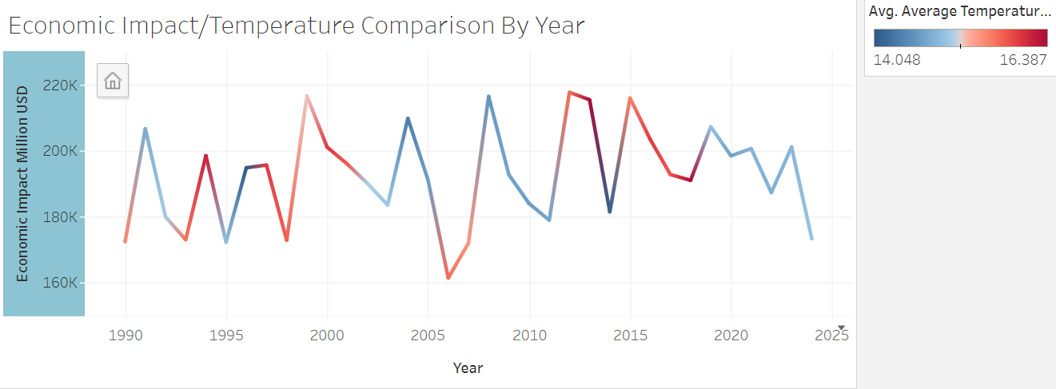
Economic Impact Over Time: The economic impact of climate change on agriculture has steadily increased, with spending rising by nearly $50 million from the start to 2015.
Inconsistent Correlation: While both metrics fluctuate, no clear pattern links economic impact and temperature changes, except for a slight correlation since 2019 with cooler temperatures.
Decade Breakdown: Economic impacts show more consistent fluctuations in the 1990s and 2010s, with the 2000s showing a more erratic trend.

Slide 5
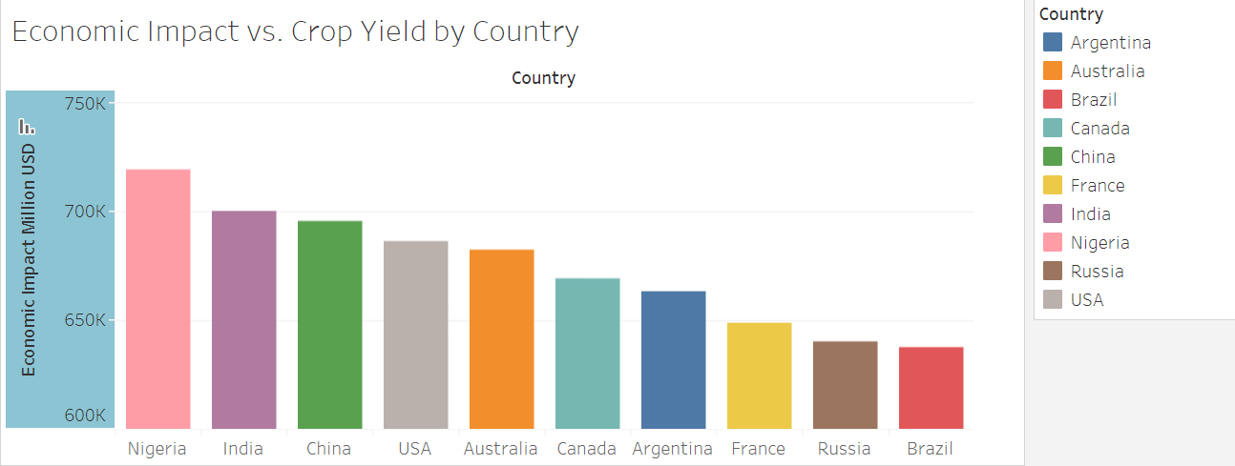
Economic Impact by Country: Despite global warming, each country has experienced relatively equal economic impact, with Nigeria leading in crop yield returns.
Future Economic Conditions: Economic outcomes in the future will depend on evolving climate patterns and their effects on individual crops.
Assessing Regional Trends: Evaluating neighboring countries could reveal insights, especially in areas where crop yields are below average.

Slide 6
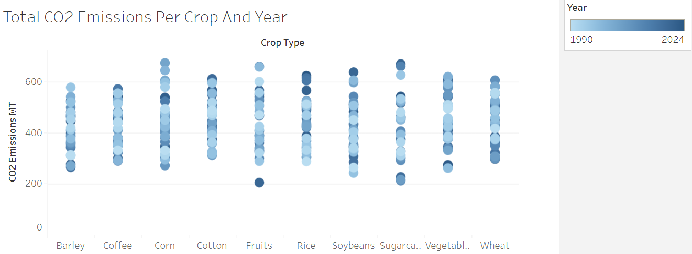
Carbon Emissions Variability by Crop: Crops like corn and vegetables have wider ranges of carbon emissions, while coffee and cotton show smaller, more consistent emissions.
Impact of Outliers: Certain crops, such as fruits and sugarcane, have outliers in carbon emissions, with some linked to recent years, possibly reflecting rising global temperatures.
Future Emissions Trends: Carbon emissions from crop production will change depending on demand and production adjustments, with timing and location playing key roles in emission reduction.

Slide 7
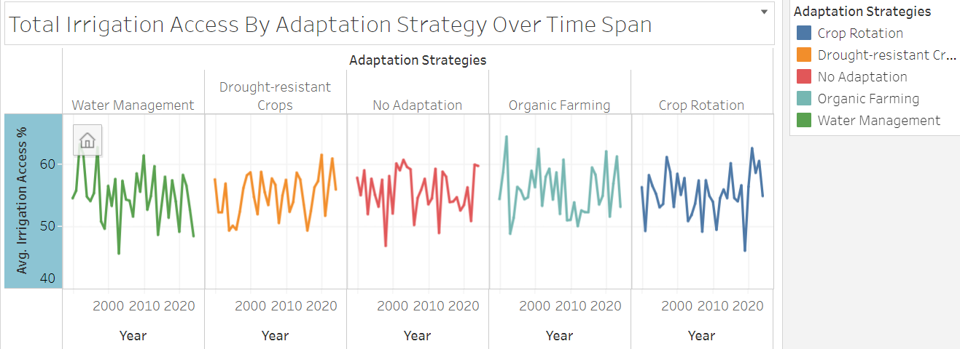
Irrigation Access Consistency: The five adaptation strategies show a consistent pattern over 25 years, with slight fluctuations, as seen in the line chart.
Water Management Decline: Water management shows a decrease over time, indicating that water shortages have been a growing issue, prompting the need for more management practices.
Growth of Drought-Resistant Crops and Organic Farming: These strategies have seen slight increases over time, suggesting they are becoming more popular and effective in dealing with the declining access to irrigation.

Slide 8
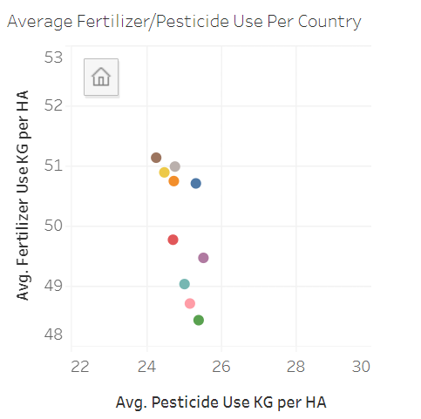
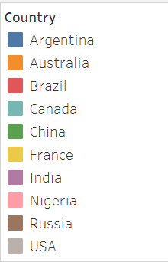
Average Usage Visualization: A scatterplot was created to display average pesticide and fertilizer use per country, with values measured in kilograms per hectare.
Russia and China Contrast: Russia uses the most fertilizer but the least pesticide, while China has the highest pesticide use and one of the lowest fertilizer uses.
Argentina's High Usage: Argentina ranks among the highest for both pesticide and fertilizer use, with potential future changes based on regulations and the impact of climate change.

Slide 9
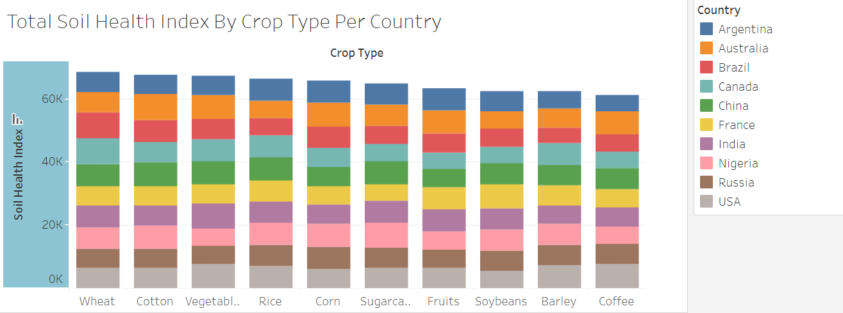
The total soil health index by crop type for each country is evaluated with the creation of a bar chart, which shows scores ranging between 0 and 100.
Wheat has the highest soil health index score among crops, followed by cotton and vegetables. And coffee has the lowest score across all nations.
Future changes in soil health index scores may be influenced by factors such as land management practices, groundwater levels, and pesticide use.

Slide 10
Conclusion/Recommendations
Invest in Adaptation Strategies: Prioritize research and funding for drought-resistant crops and sustainable farming practices.
Strengthen Water Management: Implement comprehensive water conservation initiatives and regulations for efficient agricultural water use.
Monitor Extreme Weather: Establish robust monitoring systems and contingency plans to support farmers during adverse weather events.

